Slide 1

HUMAN–COMPUTER INTERACTION
Explainable AI–Based
Phishing Website Detection
A Human-Centred Machine Learning & SHAP Framework for Non-Technical Users
11,430
87
6
96.63%
0.994
URLs analysed
Features
ML models
Best accuracy
ROC-AUC
NAME
STUDENT ID
SECTION
Ghulam Mustafa
F2023266796
V16
SUBJECT
SUPERVISOR
UNIVERSITY
Human–Computer Interaction
Ms. Iqra Khalil
University of Management & Technology
Notes:
Title slide. Project introduces an explainable, human-centred phishing detector combining XGBoost, SHAP and a plain-language warning interface evaluated with an 8-item HCI instrument.

Slide 2





INTRODUCTION
The Problem: Accurate Detection Is Not Enough
Phishing sites imitate trusted services and trick users into revealing passwords, banking and personal data. They exploit familiarity and urgency, not technical flaws.
FROM PROBLEM TO RESPONSE
Machine learning can flag phishing with high accuracy — but a black-box warning a user does not understand is often ignored, distrusted or misread.
Phishing imitates trusted services
→ ML detector paired with user-facing explanations
FOUR CONTRIBUTIONS OF THIS WORK
Black-box models give little reason
Predictive model
Explainability
→ SHAP + plain-language explanation of output
Six supervised classifiers trained & compared
Feature importance + SHAP on the best model
Warnings are unclear or too technical
→ Human-centred interface mock-up
Warning mock-up
Evaluation tool
Model output as plain-language guidance
8-item Likert instrument + response workbook
HCI evaluation is usually missing
→ 8-item instrument + structured workbook
Notes:
Core message: detection alone is insufficient; the system must explain risk clearly enough for ordinary users to act safely. This motivates the four contributions.

Slide 3


RELATED WORK · POSITIONING
Previous Studies & the Research Gap
Study / Prior Work | Focus & Contribution | What Was Missing — Research Gap
Hannousse & Yahiouche (2021) | Benchmark dataset & ML phishing detection | Optimised accuracy — no explanation or user warning
Chen & Guestrin — XGBoost | Scalable gradient-boosted tree classifier | High accuracy, but a black box to end users
Lundberg & Lee — SHAP | Unified feature-attribution method | General XAI, not tied to phishing warnings
Ribeiro et al. — LIME | Local surrogate explanations | Not integrated into warning-interface design
Felt et al. · Cranor | Warning comprehension & human-in-the-loop | Warning design without an ML detector behind it
Alsharnouby et al. | User study on why phishing succeeds | No explainable end-to-end detection pipeline
This study (2026) | XGBoost + SHAP + human-centred warning + HCI instrument | Unites detection, explanation & evaluation end-to-end
Research gap No prior work unites an accurate classifier, SHAP explanations and human-factors warning design with a structured HCI evaluation — the gap this study fills.
Notes:
Comparison of prior work against this study. Earlier research advanced detection, explainability or warning design in isolation; this study is the first to integrate all three plus a structured HCI evaluation instrument.

Slide 4

AIM · OBJECTIVES · QUESTIONS
Research Aim, Objectives & Research Questions
AIM Design and assess an explainable-AI framework that accurately classifies websites and presents understandable, actionable warnings to non-technical users.
O1
Pre-process & analyse the dataset
O2
Compare six supervised models
RQ1 Characteristics & class balance?
RQ2 Which model performs best overall?
O3
Identify most influential features
O4
Apply SHAP (global + local)
RQ3 Which features drive predictions?
RQ4 How can XAI add transparency?
O5
Design plain-language warning UI
O6
Build an HCI evaluation instrument
RQ5 How to present output to laypeople?
RQ6 How to measure usability & trust?
Notes:
Six objectives each map to a research question, spanning data, modelling, explainability, interface design and HCI evaluation.

Slide 5




LITERATURE REVIEW
What Prior Work Tells Us — and the Gap
Detection approaches
ML for phishing
Blacklists, heuristics, URL-, content-, reputation- and visual-similarity methods. Static rules age fast; ML generalises better to unseen pages.
Logistic Regression & single trees underfit/overfit. Tree ensembles (RF, Extra Trees, Gradient Boosting, XGBoost) excel on heterogeneous tabular features.
Explainable AI
HCI & warning design
SHAP gives consistent, locally-accurate feature attributions (Shapley values); LIME approximates locally. Faithful yet understandable explanations are key.
Warnings must be clear, actionable and well-calibrated. Poor or repeated alerts cause warning fatigue; jargon erodes trust.
RESEARCH GAP
The literature optimises predictive accuracy but neglects human understanding, explanation quality, warning usability and trust calibration. Few studies combine an accurate classifier, SHAP explanations and human-factors warning design into a single end-to-end pipeline with a structured evaluation instrument — exactly the gap this study addresses.
Notes:
Gap: integration of detection + explanation + human-centred warning design + evaluation is rarely done together.

Slide 6

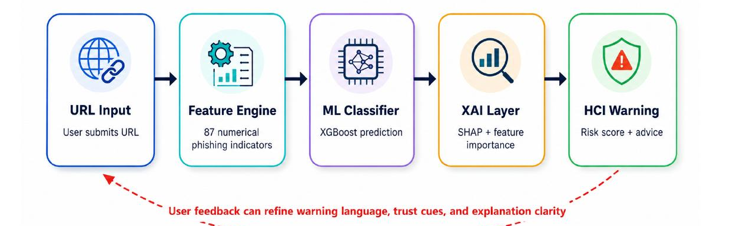





METHODOLOGY
Research Design & Modelling Pipeline
END-TO-END FRAMEWORK
Design
Split
Validation
Quantitative, experimental ML + XAI + design
80 : 20 stratified train–test (1,143 each class)
5-fold stratified CV on phishing-class F1
Selection metric
Models
Settings
Phishing-class F1 — penalises missed detections
LogReg · Tree · RF · Extra Trees · GBM · XGBoost
Default hyper-parameters — a stated limitation
Notes:
Quantitative experimental design. Stratified 80:20 split plus 5-fold CV. F1 on the phishing class chosen because false negatives are the costly error. Default hyper-parameters acknowledged as a limitation.

Slide 7
DATASET & FEATURES
Web Page Phishing Detection — Balanced & Rich
PERFECTLY BALANCED CLASSES
FEATURE TAXONOMY
5,715
5,715
URL structure
56
length, dots, hyphens, query marks, IP, tokens
Legitimate
Phishing
11,430 total URLs
Page content
24
87
89
hyperlinks, forms, scripts, page behaviour
Numeric features
Raw columns
External service
7
Source Hannousse & Yahiouche · Mendeley Data V3 · target = status (0/1)
Google index, PageRank, DNS record, web traffic
Legitimate
Phishing
Notes:
11,430 instances, perfectly balanced 5,715 / 5,715. 87 numeric features after dropping raw URL text. Three families: URL structure (56), page content (24), external reputation (7).

Slide 8


RESULTS · PERFORMANCE
Six Models Compared — XGBoost Wins
BEST OVERALL MODEL
XGBoost
Accuracy
0.96632
Precision
0.96187
Recall
0.97113
F1-score
0.96648
ROC-AUC
0.99443
Tree ensembles dominate
Extra Trees & Random Forest trail XGBoost closely; LogReg and a single tree are weakest on this structured data.
High recall = safer
97.1% recall means few phishing pages slip through — the most security-critical property.
Notes:
XGBoost leads on every metric: 96.63% accuracy, 96.65 F1, 99.44 ROC-AUC. Tree ensembles cluster at the top. High recall matters most because a missed phishing page can mean credential theft.

Slide 9

RESULTS · ERROR ANALYSIS
Confusion Matrix & Cross-Validation Stability
XGBOOST ON THE TEST SET · 2,286 PAGES
PREDICTED
Legitimate
Phishing
1099
44
2.89%
3.85%
96.15%
TN
FP
False-negative rate · security risk
False-positive rate · fatigue risk
Specificity · legit sites correctly cleared
ACTUAL
33
1110
FIVE-FOLD CROSS-VALIDATION (PHISHING-CLASS F1)
FN
TP
Model | Mean CV F1 | Std. Dev. | Stability
XGBoost | 0.96906 | 0.00202 | Most stable
Random Forest | 0.96705 | 0.00461 | Stable
Extra Trees | 0.96341 | 0.00455 | Stable
Consistent, not lucky
XGBoost has the highest mean CV F1 (0.96906) and the smallest variability (SD 0.00202) of the top three — no reliance on one lucky split. ROC-AUC ≈ 0.994 and average precision ≈ 0.99 confirm strong, threshold-robust class separation.
Notes:
Only 33 phishing pages missed (2.89% FN). 44 false positives (3.85%). XGBoost is also the most stable across folds — high mean F1, lowest SD.

Slide 10


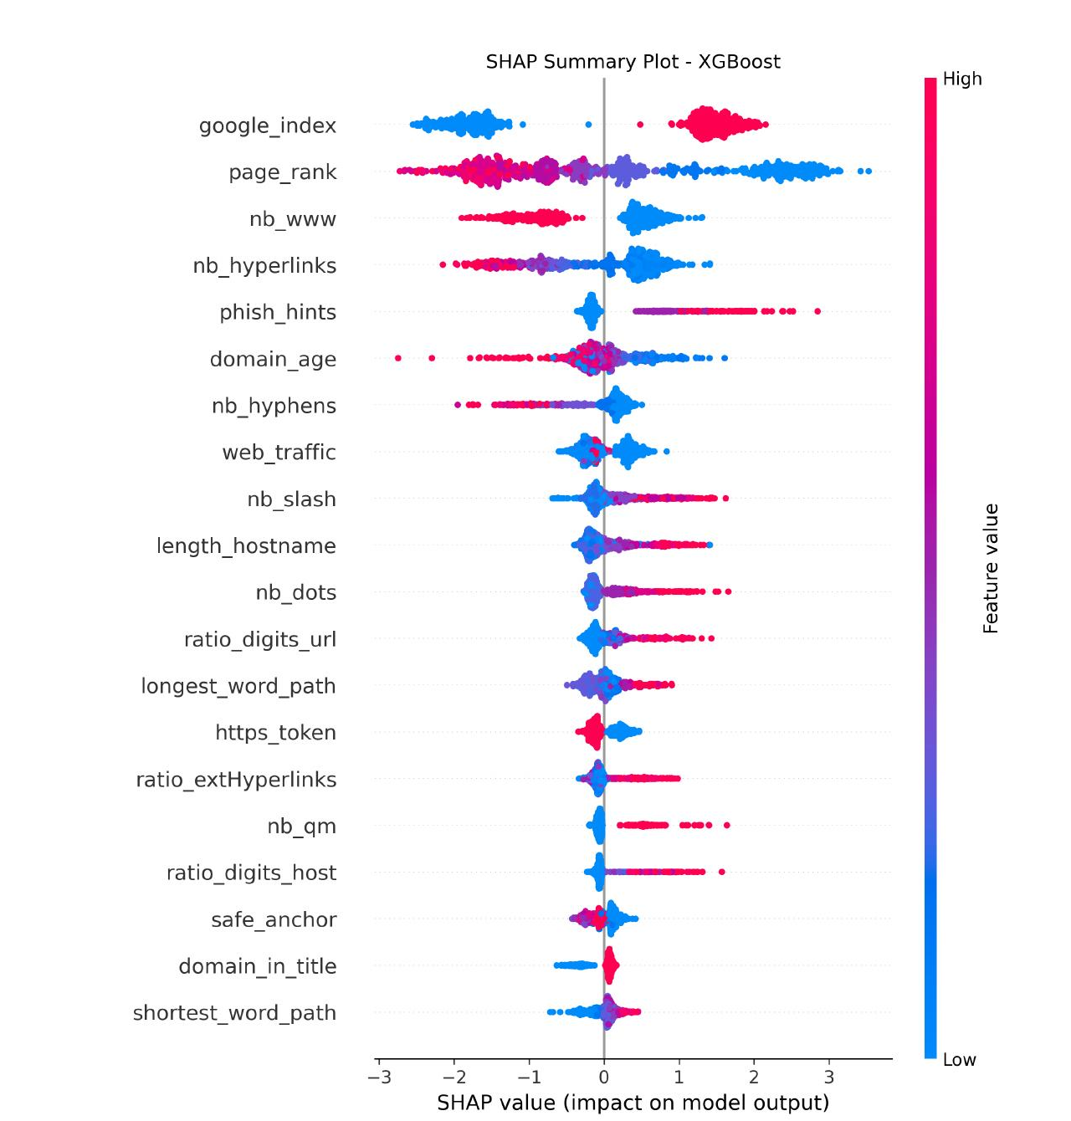
EXPLAINABLE AI
Why the Model Decides — SHAP & Feature Importance
TOP FEATURE IMPORTANCE (XGBOOST GAIN)
SHAP: TECHNICAL → PLAIN LANGUAGE
Low google_index → “Poor search-engine reputation”
Suspicious URL tokens / query marks → “The address looks unusual”
Hyperlink pattern like known phishing → “Page resembles phishing pages”
Global
Local
Summary plot ranks each feature's overall effect across many pages.
Per-prediction reasons explain why one specific page is risky.
SHAP summary plot Red = high feature value, blue = low. Position shows push toward phishing (right) or legitimate (left), making each decision auditable.
google_index dominates — external reputation is the single strongest signal.
Notes:
Feature importance and SHAP agree: external-reputation signals (Google index, PageRank, DNS) plus URL/page structure drive predictions. SHAP attributions are translated into plain-language warnings the user can act on.

Slide 11
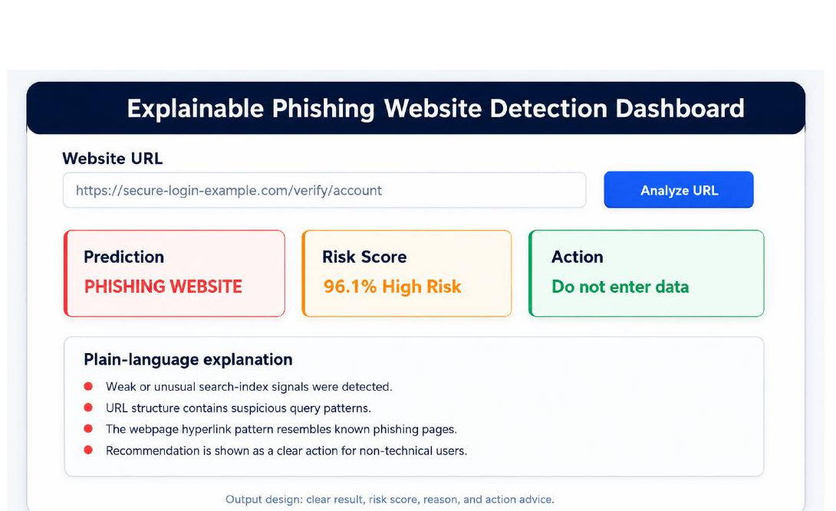

HUMAN-CENTRED DESIGN
From Model Output to a Usable Warning
FOUR VISIBLE COMPONENTS
Prediction label
Explicit “phishing / legitimate” verdict
Calibrated risk score
A numeric confidence (e.g. 96.1% high risk)
Plain-language reasons
Top SHAP signals, no technical jargon
Actionable safety advice
Concrete next step — “do not enter data”
DESIGN PRINCIPLES
Colour + text (not colour alone) for accessibility
No jargon · clear warning hierarchy
Communicates basis, not certainty → trust calibration
Interface mock-up — a static concept, not deployed software.
Notes:
Interface communicates a label, a calibrated score, plain reasons and concrete advice. Colour is backed by text for colour-blind users; it states the basis for the warning to support trust calibration rather than asserting certainty.

Slide 12

HCI EVALUATION
Pilot Workbook Results — 8-Item Likert Instrument
20
4.26
93.1%
0.954
Participants
Overall mean / 5
Overall agreement
Cronbach's α
MEAN SCORE BY ITEM (Q1–Q8)
Highest — Q5 · 4.55
Visual warning spotted risk fastest (100% agreement).
Lowest — Q7 · 3.90
Cautious trust — appropriate for a prototype.
Eight constructs measured
Usability · warning & explanation clarity · risk communication · visual cue · decision support · trust · suitability.
Notes:
Pilot/demonstration workbook with 20 responses: overall mean 4.26/5, agreement 93.1%, Cronbach's alpha 0.954 (strong internal consistency). Q5 (visual warning) highest; Q7 (trust) lowest. These illustrate the instrument; a full user study is future work.

Slide 13


DISCUSSION · LIMITATIONS · CONCLUSION
Bringing It Together
Key findings
Limitations
Conclusion & future work
XGBoost best: 96.63% acc, 0.966 F1, 0.994 ROC-AUC
Tree ensembles fit heterogeneous tabular features
External reputation + URL/page structure drive risk
SHAP makes each decision auditable & explainable
Single, possibly dated dataset; no external validation
Default hyper-parameters; no adversarial / drift testing
Relies on external services (Google, PageRank, DNS)
Interface is a mock-up; HCI data are pilot only
Accuracy + explainability + warning design together
Deploy a browser extension; validate on live feeds
Run a full user study (SUS, trust calibration)
Multilingual, QR-phishing & visual-similarity extensions
Effective phishing defence must combine accuracy, explainability and human-centred warning design — empirical evaluation with real users is the essential next step.
Notes:
Findings, limitations and conclusion side by side. Closing claim: the contribution is the integrated pipeline; usability and trust claims await a real user study.

